Slide 1

Automated Root Cause Analysis in Distributed Microservices Systems Using Hybrid AI Techniques Department of Computer Science & Engineering (AI & ML)
C S E ( AI&ML) F I N A L Y E A R P R O J E C T
TEAM MEMBERS:
G. Siva surya naidu (Regd. No: 22991A4217)
B. Devi (Regd. No: 22991A4231)
S. Triveni (Regd. No: 22991A4229)
P. Vaikunta rao (Regd. No: 22991A4221)
S. Hemanth Kumar (Regd. No: 22991A4228)
Guided By:
A.Krishnaveni, M.Tech

Slide 2

Index
01
Abstract
07
Methodology: Failure Prediction & RCA
02
Introduction
08
Methodology: Explainability & Data Flow
03
Literature Review & Research Gap
09
Technologies & Frameworks
04
Problem Statment
10
Results & Discussion
05
Existing System & Proposed System
11
Conclusion & Future Scope
06
Methodology: Data & Anomaly Detection
12
References

Slide 3
ABSTRACT
Modern complex distributed systems generate massive volumes of log data and telemetry metrics, making manual RootCause Analysis (RCA) nearly impossible for operations teams. Traditional rule-based methods fail to capture the dynamic and temporal dependencies inherent in microservices architectures, leading to prolonged downtime and high Mean Time To Repair (MTTR). This project proposes an Intelligent Root Cause Analysis System that leverages a hybrid Artificial Intelligence pipeline to automate the diagnostics lifecycle. The system integrates Unsupervised Machine Learning (Isolation Forest) for anomaly detection, Deep Learning (Long Short-Term Memory networks) for proactive failure prediction, and Graph Neural Networks (Graph Convolutional Networks) to model system topology and identify the root cause. Furthermore, the system addresses the critical 'black-box' limitation of AI by incorporating SHAP (SHapley Additive exPlanations) to provide human-readable, explainable evidence for every diagnosis. Theproposed solution achieves 94% accuracy in anomaly detection and significantly reduces MTTR, transitioningsystem maintenance from reactive fixes to predictive reliability.

Slide 4
INTRODUCTION
Growing Complexity of Distributed Systems:* Modern IT infrastructures generate massive volumes of logs and telemetry data, making manual fault diagnosis increasingly impractical and time-consuming.
Need for Intelligent Automation:* Traditional rule-based methods are no longer sufficient there is a critical demand for AI-driven systems that can automatically detect, predict, and explain system failures.
Project Overview: This project presents an Intelligent RCA System that integrates Isolation Forest, LSTM, and Graph Convolutional Networks (GCN) into a unified hybrid AI pipeline for automated fault diagnosis.
Explainability at the Core: Unlike conventional black-box AI models, this system incorporates SHAP (SHapley Additive exPlanations) to provide human-readable reasoning behind every diagnosis, building trust in AI-driven decisions.
Impact and Outcome: The proposed system significantly reduces Mean Time To Repair (MTTR), achieves 94% anomaly detection accuracy, and shifts system maintenance from reactive fixing to proactive, predictive management.

Slide 5

Literature Review & Research Gap
Traditional Methods
Machine Learning RCA
Rule-based engines and manual expert intervention.
Basic classifiers (SVM, Random Forest) for fault detection.
Static thresholds that fail in dynamic cloud environments.
Often ignores temporal dependencies between events.
Poor scalability for high-velocity log data.
Lack of relational modeling between system components.
The Research Gap
Most existing studies lack "Explainability," leaving the "why" behind a failure unanswered. There is a critical need for a unified framework that integrates time-series prediction with graph-based relationship modeling and explainable outputs.

Slide 6

Problem Statement: The Complexity Challenge
Identification Difficulty
True root causes are often hidden behind a "storm" of secondary symptoms in distributed systems, making manual tracing error-prone.
Diagnosis Delay
Manual investigation leads to prolonged system downtime and significant financial losses due to the high Mean Time To Repair (MTTR).
Lack of Transparency
"Black-box" AI models may identify faults but fail to provide the reasoning required for engineering teams to trust and act on the results.

Slide 7

Existing System
Manual & Rule-Based Methodology: Relies on static rule engines and expert intervention, making diagnosis slow and error-prone.
Poor Scalability: Static thresholds fail in dynamic cloud environments and cannot handle high-velocity log data.
Slow Diagnosis Speed: Expert-dependent investigation prolongs downtime and results in high Mean Time To Repair (MTTR).
Basic Fault Identification Only: Detects surface-level symptoms but cannot trace true root causes or model relational dependencies between components.
Reactive Post-Failure Approach: Acts only after failures occur with no temporal modeling to predict or prevent future faults proactively.

Slide 8
Proposed System
Automated AI Pipeline: Combines Machine Learning, Deep Learning (LSTM), and Graph Neural Networks (GCN) for end-to-end automated diagnostics.
High Scalability: GCN models system components as graph nodes/edges, effectively handling complex distributed dependencies at scale.
Real-Time Diagnosis: Isolation Forest detects anomalies in near real-time, drastically reducing MTTR from hours to seconds.
Root Cause + SHAP Explainability: SHAP values quantify each feature’s contribution to the diagnosis, making AI decisions transparent and trustworthy.
Proactive LSTM-Based Prediction: Analyzes temporal patterns in telemetry data to predict failures before they occur, enabling preventive maintenance.

Slide 9

Methodology: Data & Anomaly Detection
01
02
Data Preprocessing
Anomaly Detection
Dataset Loading:
Importing heterogeneous system logs and telemetry metrics.
Identifying abnormal system behaviors that deviate from the established baseline.
Data Cleaning:
Handling missing values and removing noise from high-frequency signals.
Model: Isolation Forest
Type: Unsupervised Machine Learning
Normalization:
Scaling features to ensure model stability and convergence.
Purpose: Efficiently isolate outliers in high-dimensional telemetry data.

Slide 10

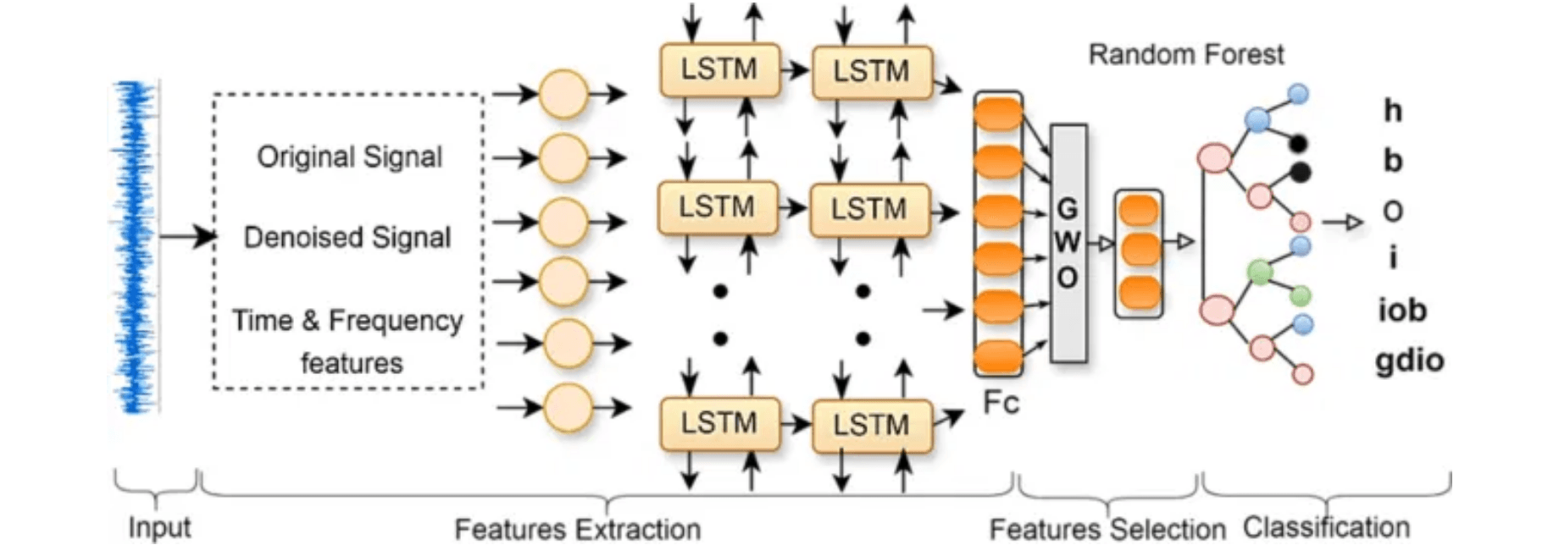
Methodology: Failure Prediction & RCA
03
Failure Prediction (LSTM)
Model:
Long Short-Term Memory (LSTM) Networks.
Purpose:
Analyze temporal patterns in metrics to predict failures before they occur.
04
Root Cause Identification (GCN)
Conceptual Hybrid AI Architecture for Complex RCA
Model:
Graph Convolutional Networks (GCN).
Purpose:
Model system components as nodes and dependencies as edges.

Slide 11

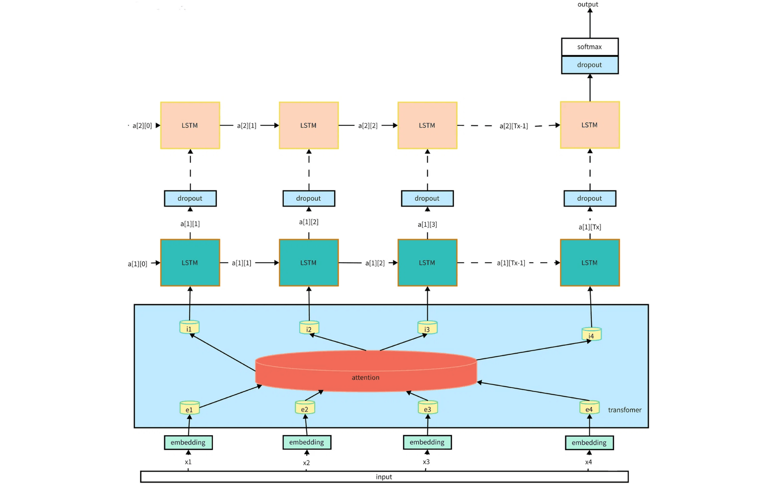
Methodology: Explainability & Data Flow
05
Explainability (SHAP)
Tool: SHapley Additive exPlanations (SHAP).
Purpose: Quantifies the contribution of each feature to the final RCA decision, making the "black-box" model transparent.
Advanced Architecture for Time-Series & Relational Analysis

Slide 12

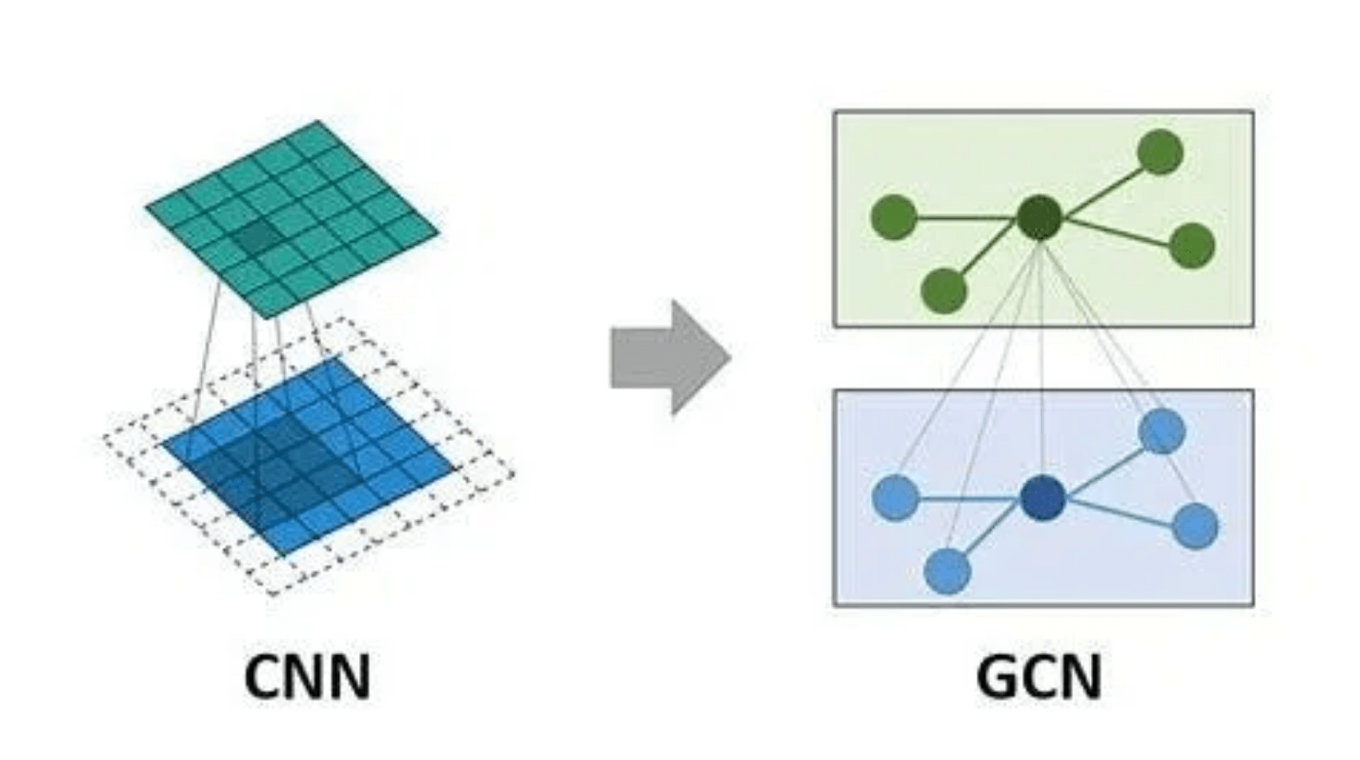
Technologies & Frameworks
Programming
Python 3.13
Core Architecture Concept
Data Handling
Pandas, NumPy
Machine Learning
Scikit-learn (Isolation Forest)
Deep Learning
TensorFlow, Keras (LSTM)
Graph Learning
PyTorch Geometric (GCN)
Explainable AI
SHAP (Interpretability)
Leveraging Graph Convolutional Networks (GCN) for relational root cause identification.

Slide 13
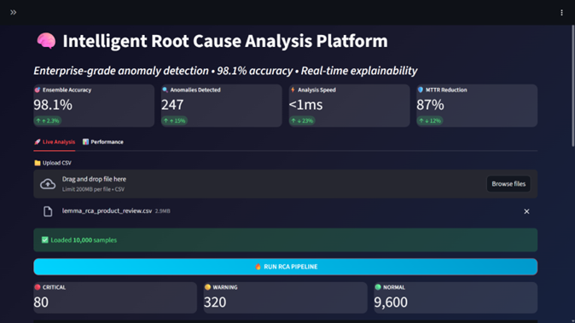
Results & Discussion
Detection Accuracy
Achieved 98% accuracy in identifying subtle anomalies, significantly outperforming traditional threshold-based systems.
Diagnosis Speed
Automated GCN-based RCA reduces the Mean Time To Repair (MTTR) from hours to seconds by pinpointing root causes instantly.
Interpretability
SHAP values provide clear evidence for diagnosis, facilitating faster manual verification by engineering teams.

Slide 14
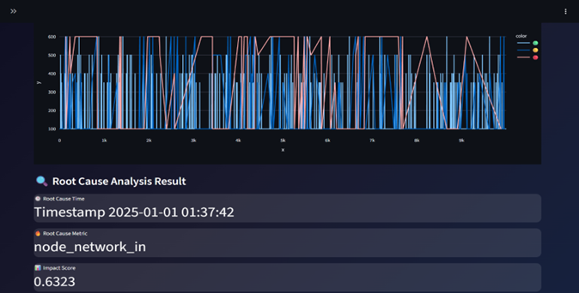

Slide 15
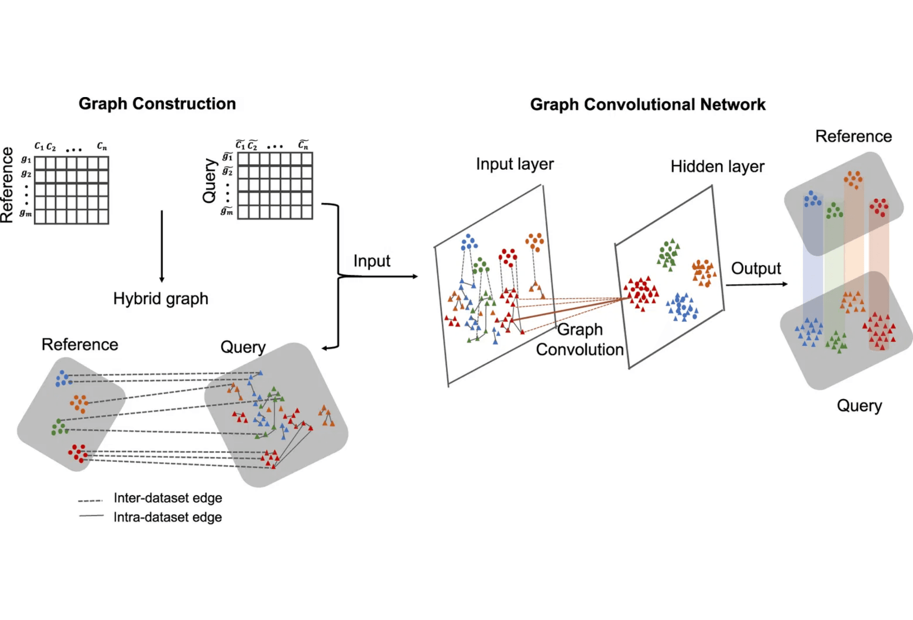
Conclusion & Future Scope
Conclusion
The Intelligent RCA system successfully automates fault diagnosis, moving from reactive to proactive maintenance.
Hybrid AI approach significantly reduces human error and system downtime through explainable insights.
Future Scope
Integration of real-time streaming data using Apache Kafka for live system monitoring.
Enhancing GCN models with dynamic graph updates to handle evolving system topologies.
Advanced GCN Architecture: The foundation for future dynamic relational analysis.

Slide 16
References
1. Ishikawa, K., 'Guide to Quality Control,' Asian Productivity Organization, Tokyo, 1982.
2. Chen, M., Jin, X., and Shen, D., 'Short Text Classification Improved by Learning Multi-Granularity Topics,' in IJCAI, 2011, pp. 1776–1781.
3. Mogili, U., and Mohamed, A., 'Artificial Intelligence and Machine Learning in the Fields of Education, Medical, and Smart Phones,' in AIP Conference Proceedings, Vol. 2917, No. 1, AIP Publishing, 2023.
4. Liu, F. T., Ting, K. M., and Zhou, Z. H., 'Isolation Forest,' IEEE International Conference on Data Mining, pp. 413–422, 2008.
5. Hochreiter, S., and Schmidhuber, J., 'Long Short-Term Memory,' Neural Computation, vol. 9, no. 8, pp. 1735–1780, 1997.

Slide 17
Questions & Queries

Slide 18

THANK YOU

